Slide 1
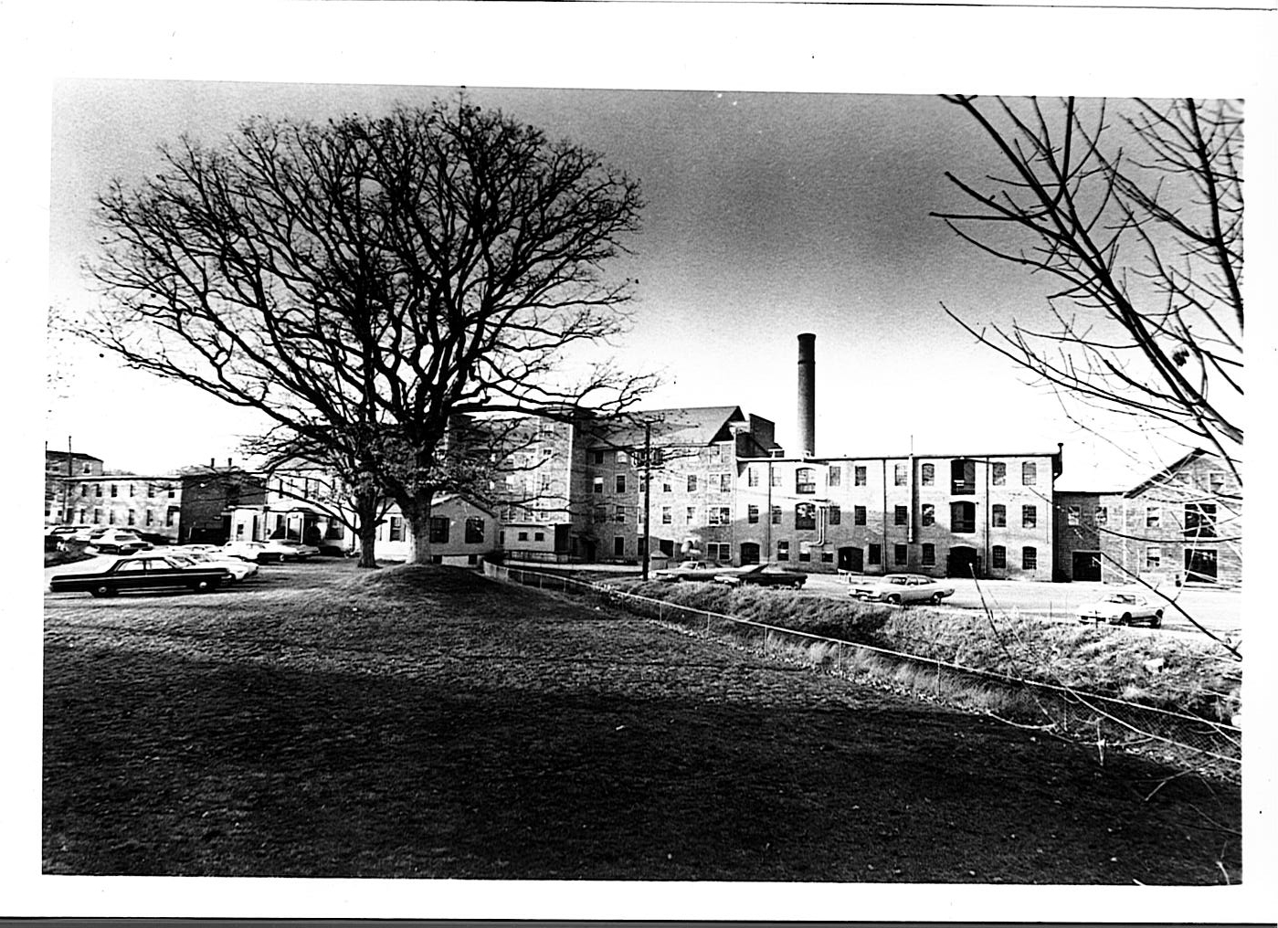

Slide 2
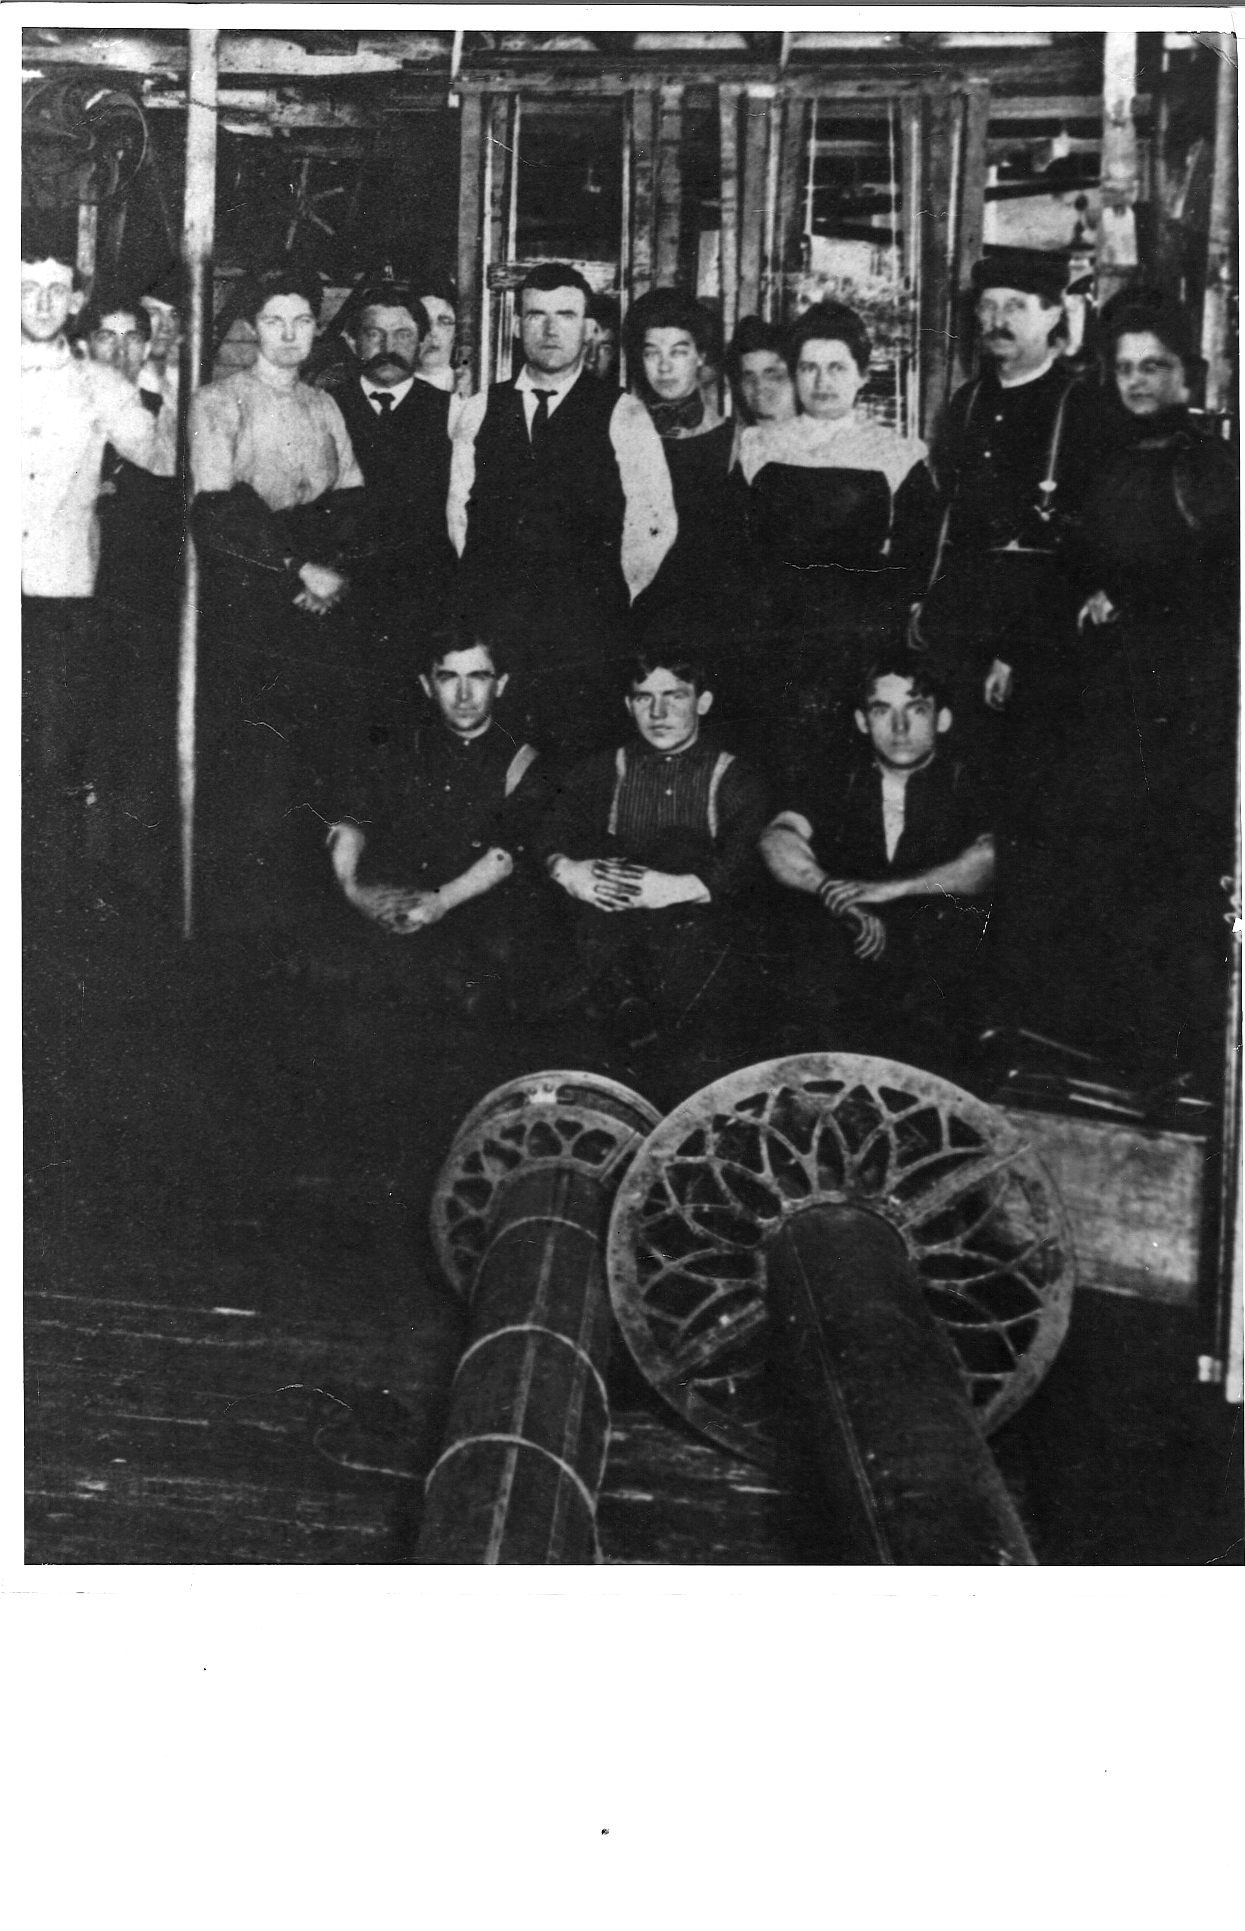

Slide 3
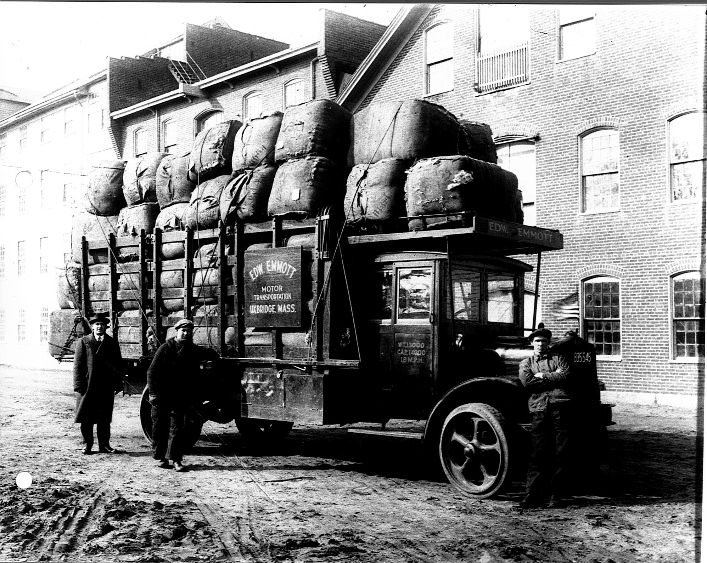

Slide 4
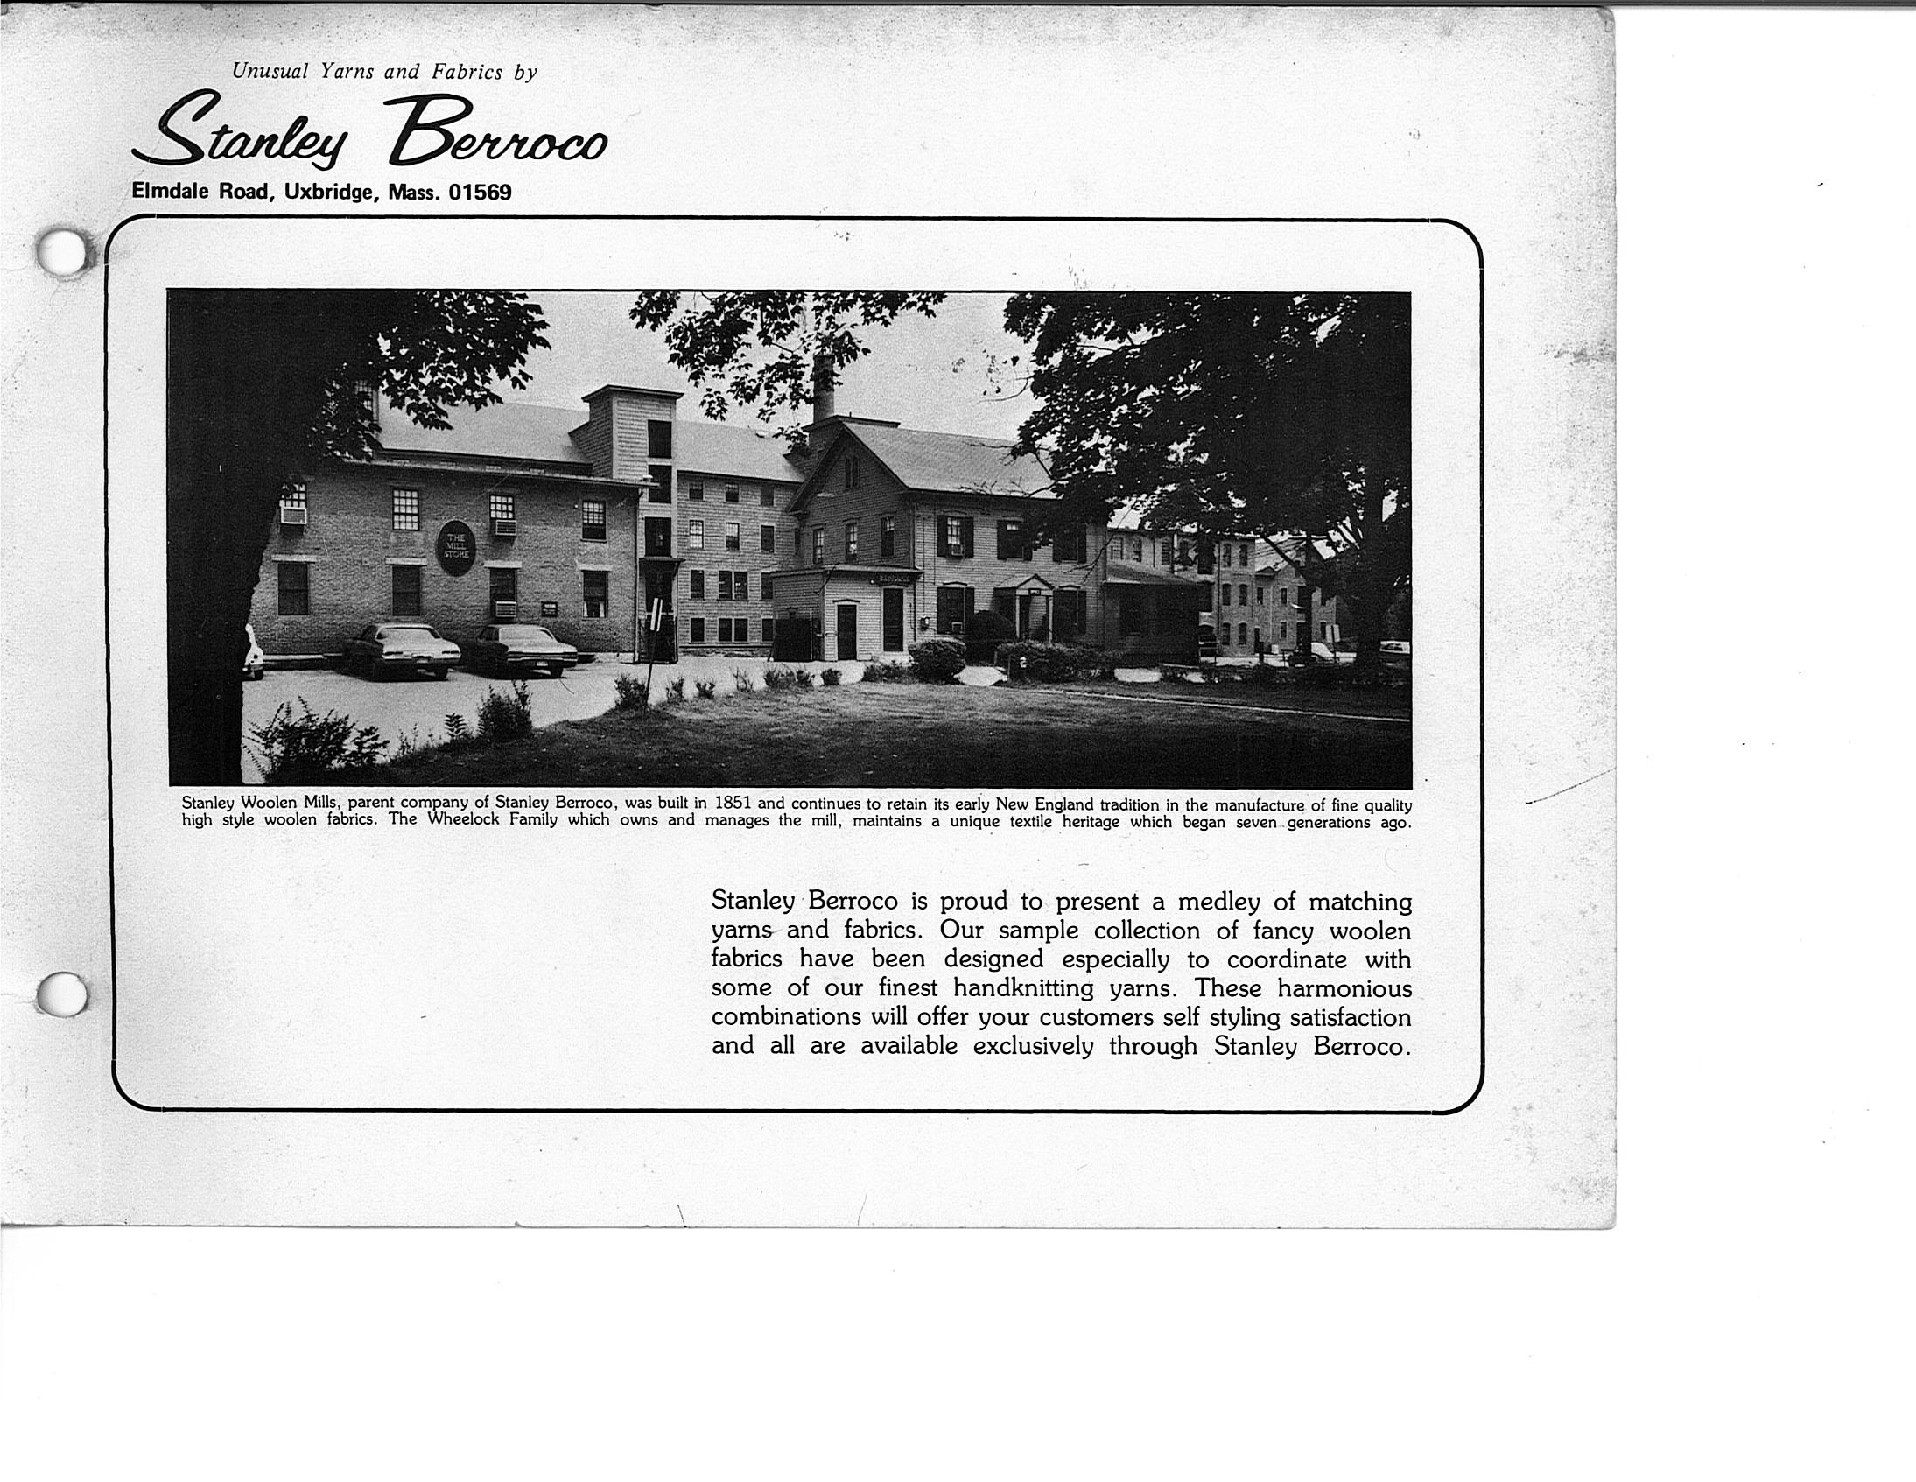

Slide 5
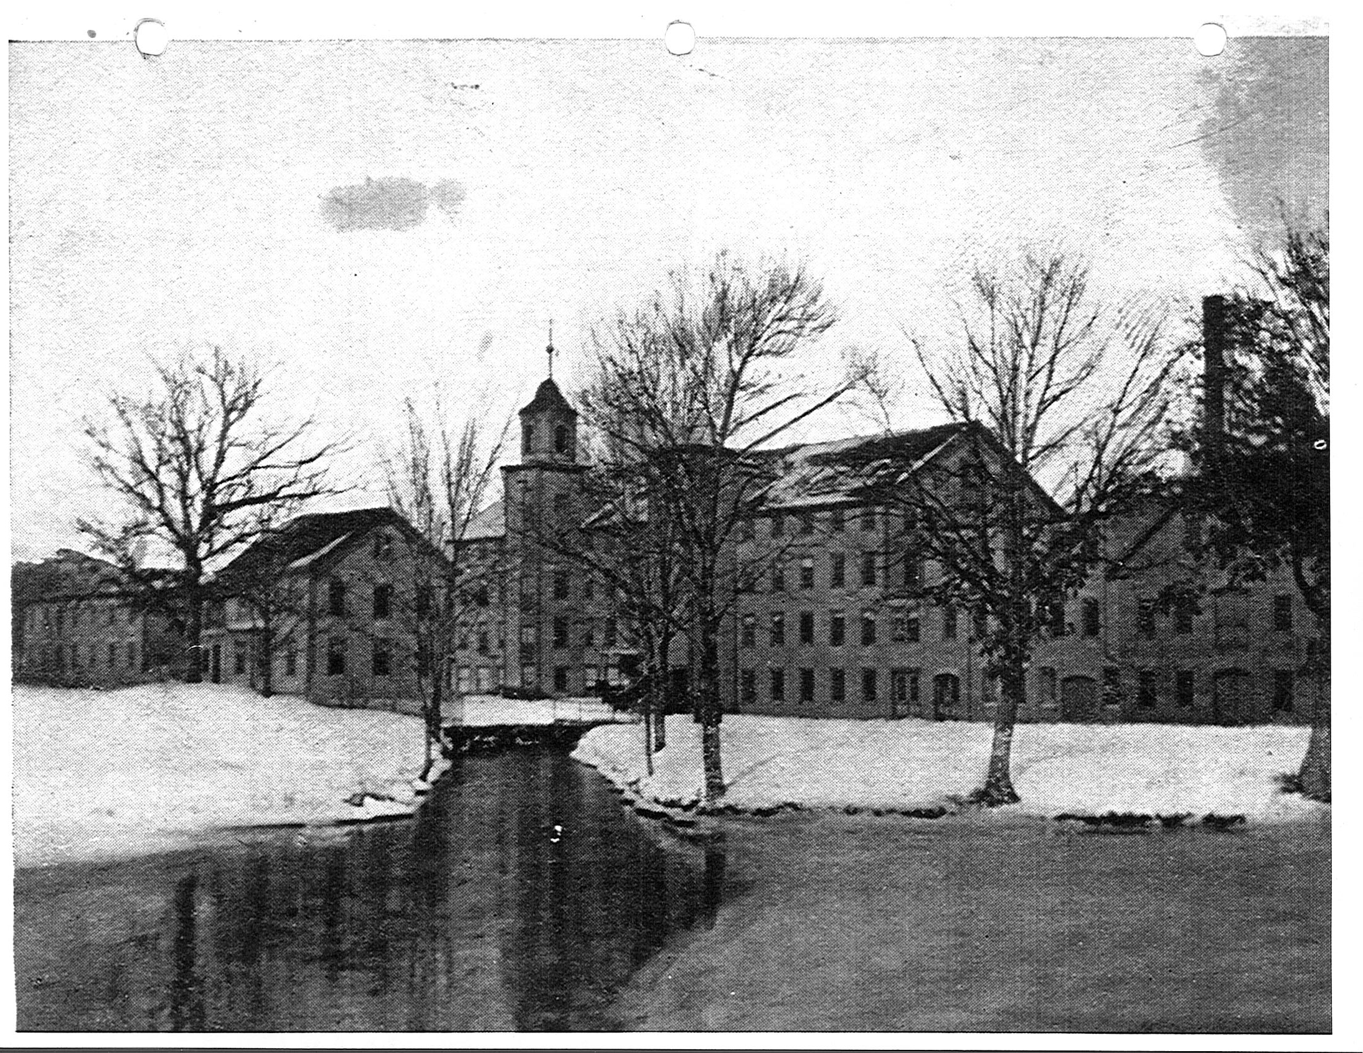

Slide 23
Notes:
Walter Morven

Slide 34
Notes:
Steven Jaziorsky

Slide 40
Notes:
Katherine Dorsey

Slide 42
Notes:
Dressing Room

Slide 43
Notes:
Dressing Room

Slide 44
Notes:
Dressing Room

Slide 45
Notes:
Rooftop view from Dressing Room

